Slide 1
Motivating Satisfying Employees and Teams

Slide 2
Learning Objectives
10-1 Explain what motivation is.
10-2 Understand some major historical perspectives on motivation.
10-3 Describe three contemporary views of motivation: equity theory, expectancy theory, and goal-setting theory.
10-4 Explain several techniques for increasing employee motivation.
10-5 Understand the types, development, and uses of teams.

Slide 3

What Is Motivation?
The individual internal process that:
  Energizes
  Directs
  Sustains behavior
Notes:
Additional Resources: http://www.motivaction.co.uk/news/Employee-motivation%3A-Team-building-should-be-a-day-to-day-business-801538483.news

Slide 4
Morale
An employee’s feelings about:
  His or her job
  Superiors
  About the firm itself
Job
Satisfaction of needs
High Morale

Slide 5
Scientific Management
Scientific management: the application of scientific principles to management of work and workers
Frederick W. Taylor
  Observed that workers “soldiered” because they feared losing their jobs if there was no work
  Led to development of scientific management
  Ideas also lead to the piece-rate system
  Determine the job output to expect
  Choose and train the best person for each job
  Cooperate with workers

Slide 6
Piece-rate System
  Compensation system under which employees are paid a certain amount for each unit of output they produce
The more a person produces
The more he or she should be paid

Slide 7
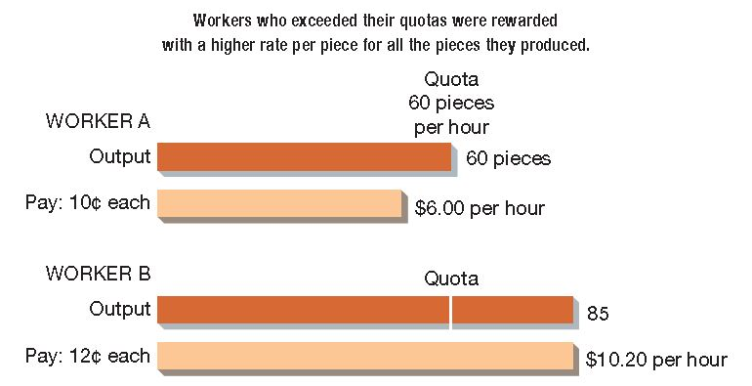
Taylor’s Piece-Rate System

Slide 8
The Hawthorne Studies
Conducted by Elton Mayo between 1927
and 1932
Determined the effects of the work environment on employee productivity
  1st experiment—Productivity of both groups increased after lighting was varied in the workplace
  2nd experiment—Workers under a piece-rate system produced at constant rates
Conclusion: Human factors are at least as important to motivation as pay rates
Notes:
Additional Resources: http://www.businessinsider.com/working-conditions-at-an-amazon-warehouse-2013-2

Slide 9
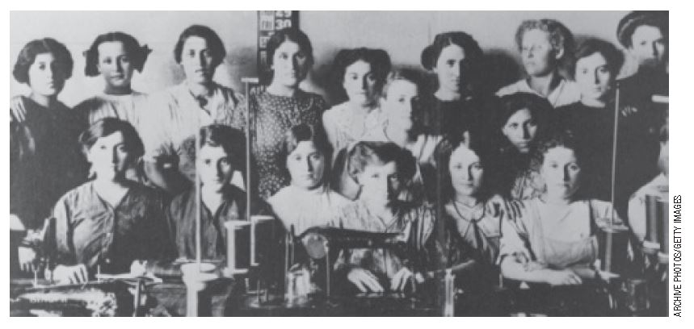
The Human Relations Movement
Employees who are happy and satisfied are motivated to perform better
Management is best served by providing a
work environment that maximizes employee satisfaction

Slide 10
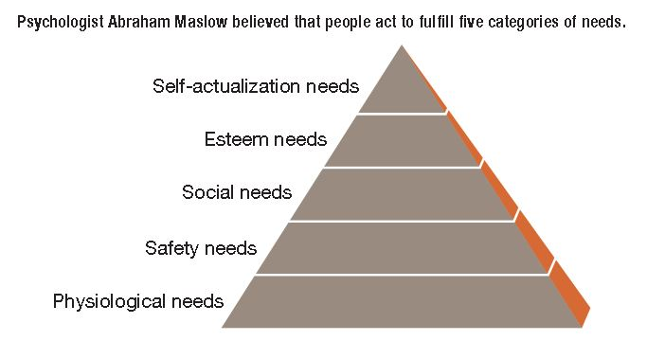
Maslow’s Hierarchy of Needs
Notes:
Additional Resources: http://en.wikipedia.org/wiki/Abraham_Maslow

Slide 11
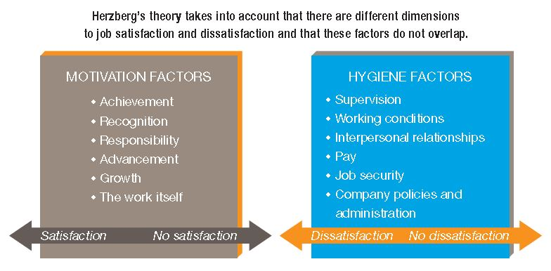
Herzberg’s Motivation–Hygiene Theory
Notes:
Additional Resources: http://www.youtube.com/watch?v=PA54HWLZ2e4

Slide 12
Using Herzberg’s
Motivation–Hygiene Theory
Managers should make hygiene as positive as possible, but should expect only short-term improvement in motivation
Managers must focus on providing those motivation factors that will enhance motivation and long-term effort
Limitations: In practice, pay has more effect than Herzberg’s theory indicates

Slide 13
Class Exercise 1
Companies use travel awards as incentives for better employee performance.
According to the motivation–hygiene theory, when an incentive for higher performance is not provided, is that a dissatisfier?

Slide 14
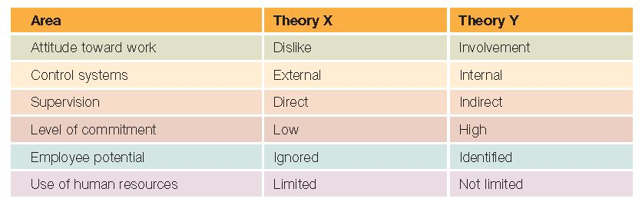
Theory X and Theory Y
Concepts advanced by Douglas McGregor

Slide 15
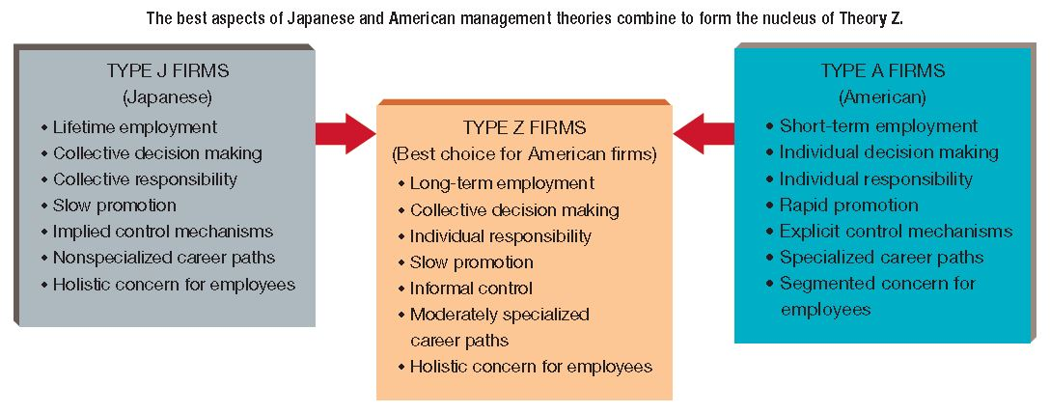
Theory Z
The belief that some middle ground between type A and type J practices is best for American business

Slide 16
Class Exercise 2
Can you think of any potential disadvantages of Theory Z management practices?

Slide 17

Reinforcement Theory
Based on the premise that rewarded behavior is likely to be repeated, whereas behavior that is punished is less likely to recur
Notes:
Additional Resources:
http://insight.kellogg.northwestern.edu/article/reward_now_punish_later

Slide 18
Types of Reinforcement
Positive Reinforcement
  Strengthens desired behavior by providing a reward
Punishment
  Undesired consequence of undesirable behavior
Negative Reinforcement
  Strengthens desired behavior by eliminating an undesirable task or situation
Extinction
  Not responding to undesirable behavior in order to discourage its occurrence

Slide 19
Equity Theory
Effort
Outcomes
Benefits
Skills
Education
Time
Inputs
Promotions
Pay
Recognition
Based on the premise that people are motivated to obtain and preserve equitable treatment for themselves
Equity is the distribution of rewards in direct proportion to each employee’s contribution to the organization

Slide 20
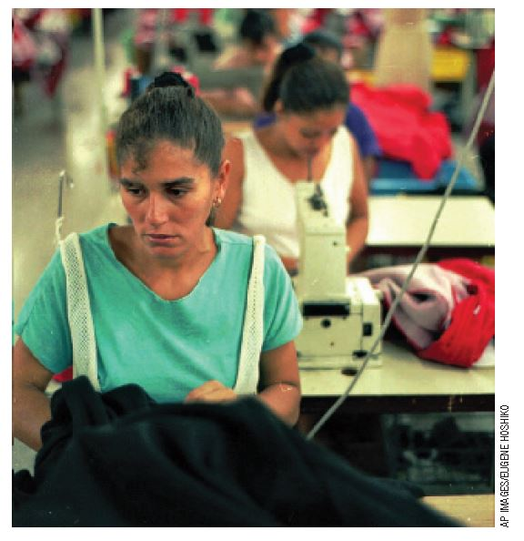
Class Exercise 3
Employees want to be treated fairly. Employees compare the amount of effort they put into their jobs and the outcomes they get to that of their coworkers. At sweatshops such as this one, though, all employees are treated unfairly.
Does equity theory come into play in this instance?

Slide 21
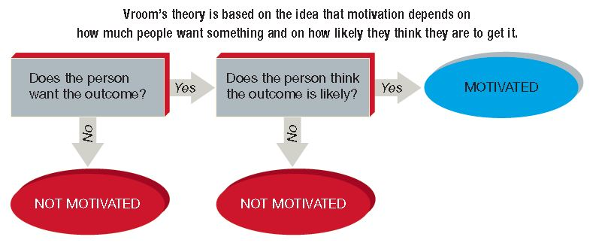
Expectancy Theory
Motivation depends on how much we want something and on how likely we think we are to get it
Expectancy theory is complex because each action we take is likely to lead to several different outcomes; some we may want, and others we may not want

Slide 22

Goal-Setting Theory
Employees are motivated to achieve goals they and their managers establish together
The goal should be:
  Very specific
  Moderately difficult
  One that the employee
  will be committed to
  achieve
Rewards should be tied directly to goal achievement
Notes:
Additional Resources: http://www.youtube.com/watch?v=usN6nu_nuKg

Slide 23
Class Exercise 4
Describe the job situations in which the following motivation theories would be most appropriate
  Scientific management
  McGregor’s Theory X
  McGregor’s Theory Y
  Theory Z
  Maslow’s hierarchy of needs
  Herzberg’s motivation-hygiene theory
  Equity theory
  Expectancy theory
  Reinforcement

Slide 24
Key Motivation Techniques
Management by objectives
Job enrichment
Behavior modification
Flextime
Part-time work and job sharing
Telecommuting
Employee empowerment
Employee ownership
Notes:
Additional Resources: http://visual.ly/motivation

Slide 25
Management by Objectives (MBO)
Motivation technique in which managers and employees collaborate in setting goals
Primary purpose is to clarify the roles employees are expected to play in reaching the organization’s goals
Increases employee motivation by empowering them with an active role in goal-setting and performance evaluation
Notes:
Additional Resources: http://www.economist.com/node/14299761

Slide 26
Management by Objectives:
Advantages and Disadvantages
Advantages
Actively involves employees
Improves communication
Employees feel like an important part of the organization
Periodic review enhances control
Disadvantages
Doesn’t work if the process doesn’t begin at the top of the organization
Can result in excessive paperwork
Some managers assign goals instead of collaborating on creating them
Goals should be quantifiable

Slide 27
Job Enrichment
Job enrichment: a motivation technique that provides employees with more variety and responsibility in their jobs
Job enlargement: expanding a worker’s assignments to include additional but similar tasks
Job redesign: a type of job enrichment in which work is restructured to cultivate the worker–job match
Notes:
Additional Resources: http://www.techrepublic.com/blog/tech-manager/job-enrichment-vs-job-enlargement/7695
Read about other ways in which managers redesign jobs at http://www.citeman.com/13452-techniques-for-designing-jobs.html

Slide 28
Behavior Modification
Systematic program of reinforcement to encourage desirable behavior
Involves both rewards to encourage desirable actions and punishments to discourage undesirable actions

Slide 29
Class Exercise 5
Studies have shown that rewards, such as compliments and expressions of appreciation, are much more effective behavior modifiers than punishments, such as reprimands and scorn.
Do you think that this is true in all situations? Identify some situations in which this may
not be true.

Slide 30
Flextime
System in which employees set their own work hours within employer-determined limits
Bands of time
    Core time, when all employees must be at work
    Flexible time, when employees may choose whether to be at work

Slide 31
Flextime: Benefits and Drawbacks
Benefits
Employees have a sense of independence and autonomy
Employees with enough time to deal with non-work issues are more productive and satisfied
Drawbacks
Supervisor’s job is complicated by having employees who come and go at different times
Employees without flextime resent co-workers who have it

Slide 32
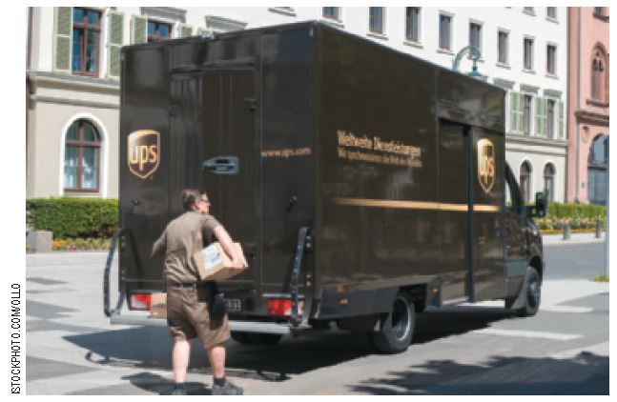
Part-Time Work
Permanent employment in which individuals work less than a standard work week
Disadvantage
  Often does not provide the benefits that come with a full-time position
Notes:
Additional Resources: http://hrweb.berkeley.edu/er/leaves/flexible/choose/part-time

Slide 33

Job Sharing
An arrangement whereby two people share one fulltime position

Slide 34

Telecommuting
Telecommuting is working at home all the time or for a portion of the work week
Individuals can set their own hours and have more time with
their families

Slide 35
Telecommuting:
Advantages and Disadvantages
  Advantages
Increased productivity
Lower costs
Reduced absenteeism
Increased work/life balance
Access to additional labor pools
  Disadvantages
  Feelings of isolation
  Putting in longer hours
  Distractions at home
  Difficulty monitoring productivity
Notes:
Additional Resources: http://www.youtube.com/watch?v=ugz3obFBNZA

Slide 36
Class Exercise 6
How do you think telecommuting, job sharing, flextime, and part-time work influence the human relations function in organizations?
How will team-building or motivational activities differ from those in traditional organizations?
Design a plan for team building in an organization in which half the workforce uses telecommuting, job sharing, flextime, and part-time work.

Slide 37
Employee Empowerment
Making employees more involved in their jobs by increasing their participation in decision making
Management must be involved to:
  set expectations
  communicate standards
  institute periodic evaluations
  guarantee follow-up

Slide 38
Employee Empowerment:
Benefits and Obstacles
Benefits
Increased job satisfaction
Improved job performance
Higher self-esteem
Increased commitment
Obstacles
Management resistance
Workers’ distrust of management
Insufficient training
Poor communication

Slide 39

Employee Ownership
Employees own the company they work for by virtue of being stockholders
Directly reward employees for success
Notes:
Additional Resources: http://www.retail-week.com/in-business/retail-surgery/what-are-the-benefits-of-employee-ownership-and-is-it-viable-for-retailers/5045625.article?blocktitle=In-Depth&contentID=5965

Slide 40

What Is a Team?
A team is formed when two or more workers operating as a coordinated unit to accomplish a specific task or goal
Notes:
Additional Resources: http://www.youtube.com/watch?v=zacF1pZR1Fg

Slide 41
Types of Teams
Problem-Solving Team
  Knowledgeable employees brought together to tackle a specific problem
Self-Managed Work Team
  Employees with the authority and skills to manage themselves
Cross-Functional Team
  Individuals with varying specialties, expertise, and skills that are brought together to achieve a common task
Virtual Team
  Members who are geographically dispersed but communicate electronically

Slide 42
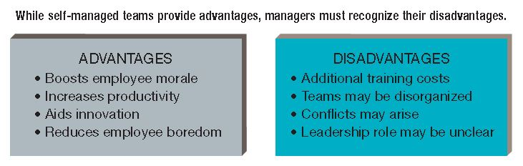
Advantages and Disadvantages of
Self-Managed Teams

Slide 43
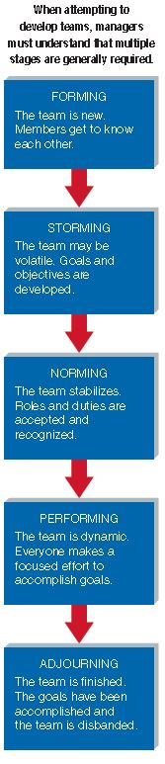
Stages of Team Development
Forming
Storming
Informing
Performing
Adjourning

Slide 44
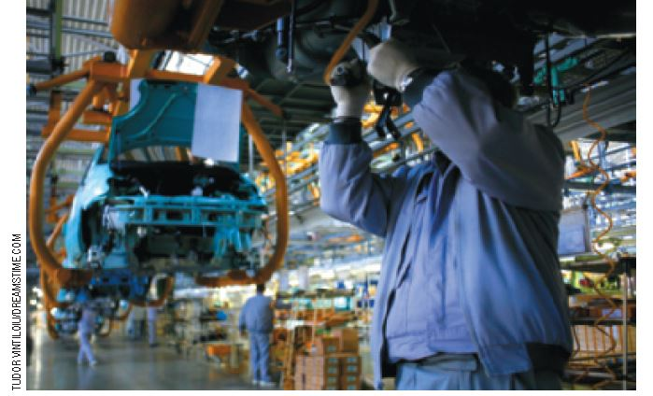
Roles Within a Team
Task-specialist role
Socioemotional role
Dual role
Nonparticipant
role

Slide 45
Team Cohesiveness
A successful team has:
  Members who get along and accomplish tasks
  Ideally 5–12 people
  Competition with other teams
  Agreed upon goals

Slide 46

Team Conflict and How to Resolve It
Middle ground resolution satisfies each party to some extent

Slide 47
Benefits and Limitations of Teams
Benefits
  Reduces turnover and costs, increases production, quality, customer service, job satisfaction
Limitations
  Reorganizing into teams can be stressful and time consuming with no guarantee it will develop effectively

